Slide 1


Welcomes You All
Webinar #1077
Xmind:Mind Map & Brainstorm
(Hindi)

Slide 2

Mind mapping- Your ways to better Learning
Dr. Meenakshi Rathi
Assistant Professor, Commerce,
Institute for Excellence in Higher Education, Bhopal
Department of Higher Education, Madhya Pradesh

Slide 3


Session is all about ……………..
Concept of Mind- Mapping - For better engagement and effective delivery of content.
Online Mindmap Creation Tools (Ideal Teaching learning Tool for making Complex subjects easy)
Hands on Session (Mind-mapping) X Mind

Slide 4


Pedagogical Transformation/शैक्षणिक परिवर्तन
In Online learning there is a shift away from top-down lecturing and passive students to a more interactive, collaborative approach.
ऑनलाइन शिक्षण एक शैक्षणिक बदलाव को उत्प्रेरित कर रहा है जिसके द्वारा टॉप-डाउन लेक्चरिंग और निष्क्रिय छात्रों से एक अधिक इंटरैक्टिव, सहयोगी दृष्टिकोण में बदलाव होता है जिसमें छात्र और प्रशिक्षक सीखने की प्रक्रिया का सह-निर्माण करते हैं।
The Instructor’s role is changing from the
“Sage on the Stage”………………. to the …………………..“Guide by the Side.”

Slide 5

Problems faced….
Creation of Impact / प्रभाव
Lack of Recall due to less attention span
Creation of Interest/
रूचि
Poor Photographic Memory

Slide 6
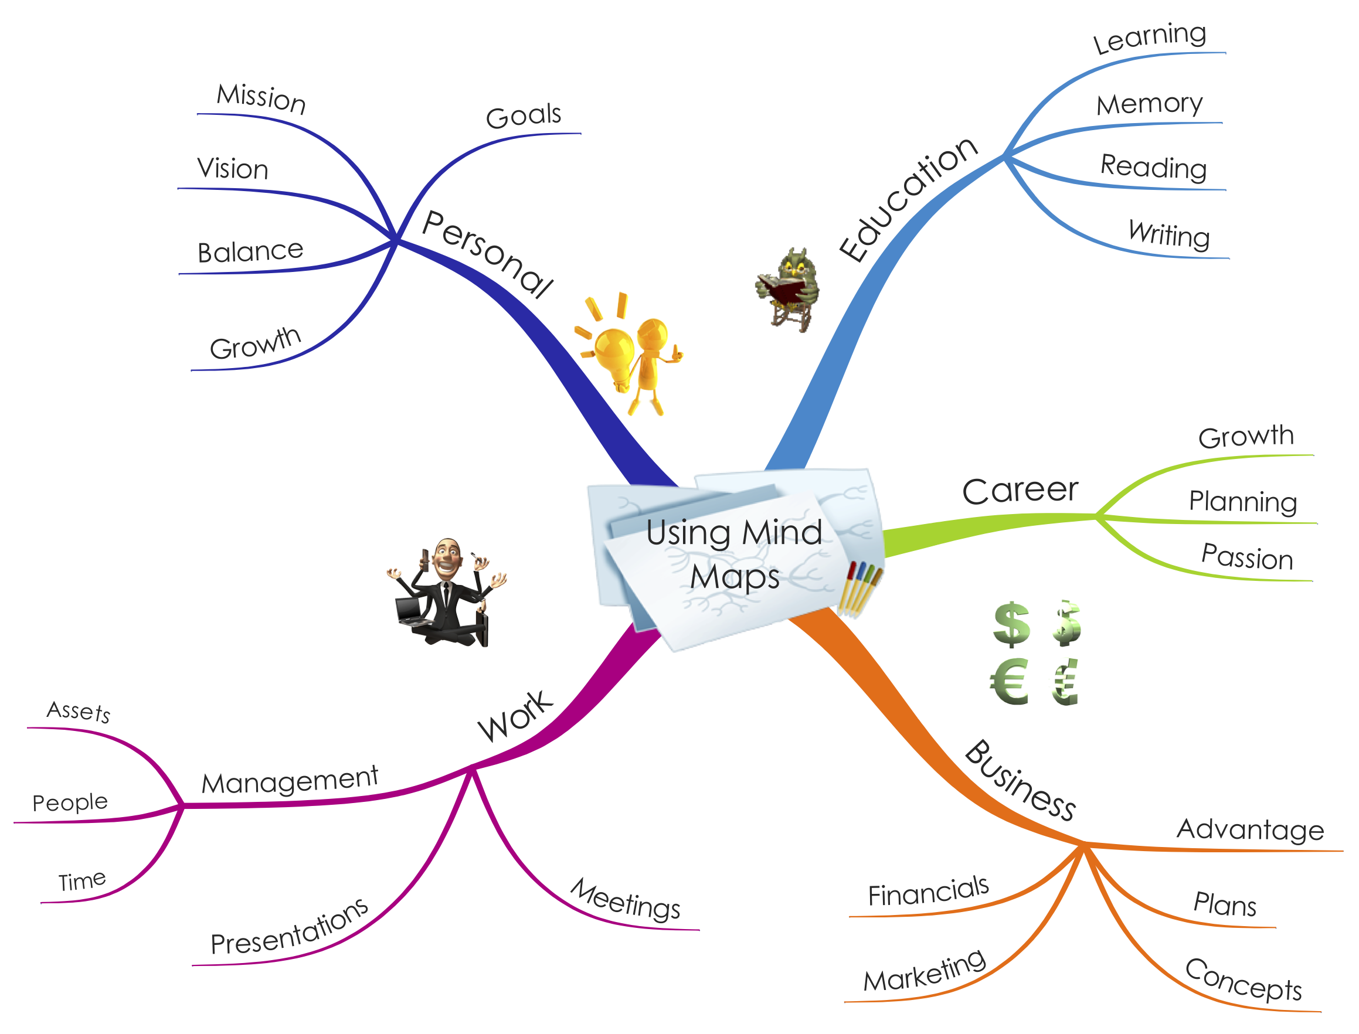
What is Mind Mapping????
A mind map is a graphical way to represent ideas and concepts (विचार एवं अवधारणाओं). It is a visual thinking tool that helps structuring information, helping you to better analyze, comprehend, synthesize, recall and generate new. जिससे आपको बेहतर विश्लेषण, समझ, संश्लेषण, याद करने और नया उत्पन्न करने में मदद मिलती है।
They are powerful graphic technique you can use to translate what is there in your mind into a visual picture.
यह एक शक्तिशाली ग्राफिक तकनीक हैं जिनका उपयोग आप अपने दिमाग में एक दृश्य चित्र में अनुवाद करने के लिए कर सकते हैं।
Mind Map

Slide 7
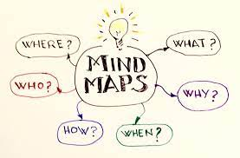
Mind-mapping for Students
Mind mapping is a study technique in which information from a variety of sources is converted into a diagrammatic representation of the important key words associated with a study topic.
Mind Maps are a unique thinking tool that will bring out students natural genius and enable them to shine in every subject.
माइंड मैप्स छात्रों की प्राकृतिक प्रतिभा को सामने लाएगा और उन्हें हर विषय में चमकने में सक्षम बनाएगा।

Slide 8
Characteristics of Mind- Map (MM)
1
MM are Radiant in nature. (विकिरणकारी)
2
Central theme with topics and sub-topics
3
Colorful and pictorial
4
Shows a lot of Information
5
Informative branches comprises of keywords and image

Slide 9
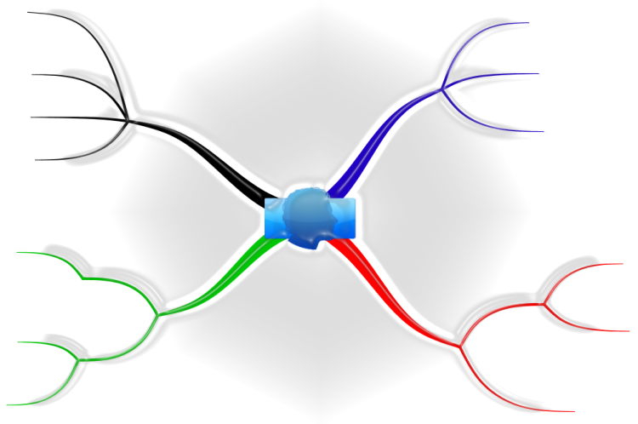
All about Mind-map…..
Keywords/Images/Graphs/ Gifs/ Extensions on Branches
Colourful & Pictorial
Radiant in Nature
Central Theme
Topics and Subtopics
Full of Information

Slide 10
Characteristics of Mind- Map (MM)
1
MM are Radiant in nature.
2
Central theme with topics and sub-topics
3
Colorful and pictorial
4
Shows a lot of Information
5
Informative branches comprises of keywords and image

Slide 11
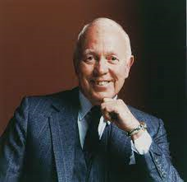

Who Has Coined the term
Sir Tony Buzan
The phrase ‘mind mapping’ was coined and popularized by British psychology author/educationist Tony Buzan.
Buzan expounded the theory that the human brain works on imaging. For instance, when he mentioned the word ‘mango’ to his audience, all of them said it was the picture (of a mango) that first came to their minds. Buzan’s thesis is that the brain works through radiant associations, colours, and multiple sensory linking.
Mind Maps !!!!!
Use Mind-map and Save Tree

Slide 12
Utility of Mind Mapping for Students
Enhances students' memory छात्रों की याददाश्त को बढ़ाता है
Increases the level of achievement / छात्रों की उपलब्धि के स्तर को बढ़ता है
मंथन करना आसान बनाएं / Brainstorming
छात्रों को पढ़ने की समझ बढ़ाने में मदद करें / Comprehension
Allow students examine relationships
Make it easy for students to classify ideas and communicate
Guide students in demonstrating their thinking process and organize them better.
Language barriers (words, grammar) are removed, so that learners can focus on the connections between information.

Slide 13
Why Should we use it ????
Mind-maps index the data systematically into your mind.
Unlock the potential of your brain.
Brain functions faster as it utilises both left and right brain.
Simplify the complex topic into simpler.
Better Understanding and learning with Fun.
A picture is worth a thousand words.
Use Mind-map and Save Tree

Slide 14
Usage of Mind-map…..
Organize Ideas
Visually organise the information
Thinking Tool
Better Use of both left and right Brain
Brainstorming
Mind-Map
Simplification of Complex Ideas
Helps in planning
Notes taking

Slide 15
Steps in Preparation of Mind Map
Step: 1 Draw Central Idea / केंद्रीय विषय
Central Idea / Main theme

Slide 16
Steps in Preparation of Mind Map
Step: 2 Add Branches
Business

Slide 17









Steps in Preparation of Mind Map
Step: 3 Expand Ideas
Business

Slide 18
Steps in Preparation of Mind Map
Step:4 Use of Symbols/ keywords
Business

Slide 19
Steps in Preparation of Mind Map
Step:5 Further Associations & relationships
Business

Slide 20
Steps in Preparation of Mind Map
Step:6 Sub-Branches/ Child Nodes/ Sibling nodes
Business

Slide 21

Features of Mind- Map software
File sharing/publishing options
Supported import file format.
Supported export file format
Available templates
Easy to use

Slide 22







Software for Mind-Map Creation
XMind
EdrawMind
Mindmeister
Mindmaster
Miro
Mindomo
Freemind
Mindmup
Coggle
Wisemapping
Smart Draw
Ayoa

Slide 23
Online Mindmap Creation Tools
Tools
X-Mind
Mindomo
FreeMind
Mindmaster
Wise-Mapping
Coggle

Slide 24


Slide 25
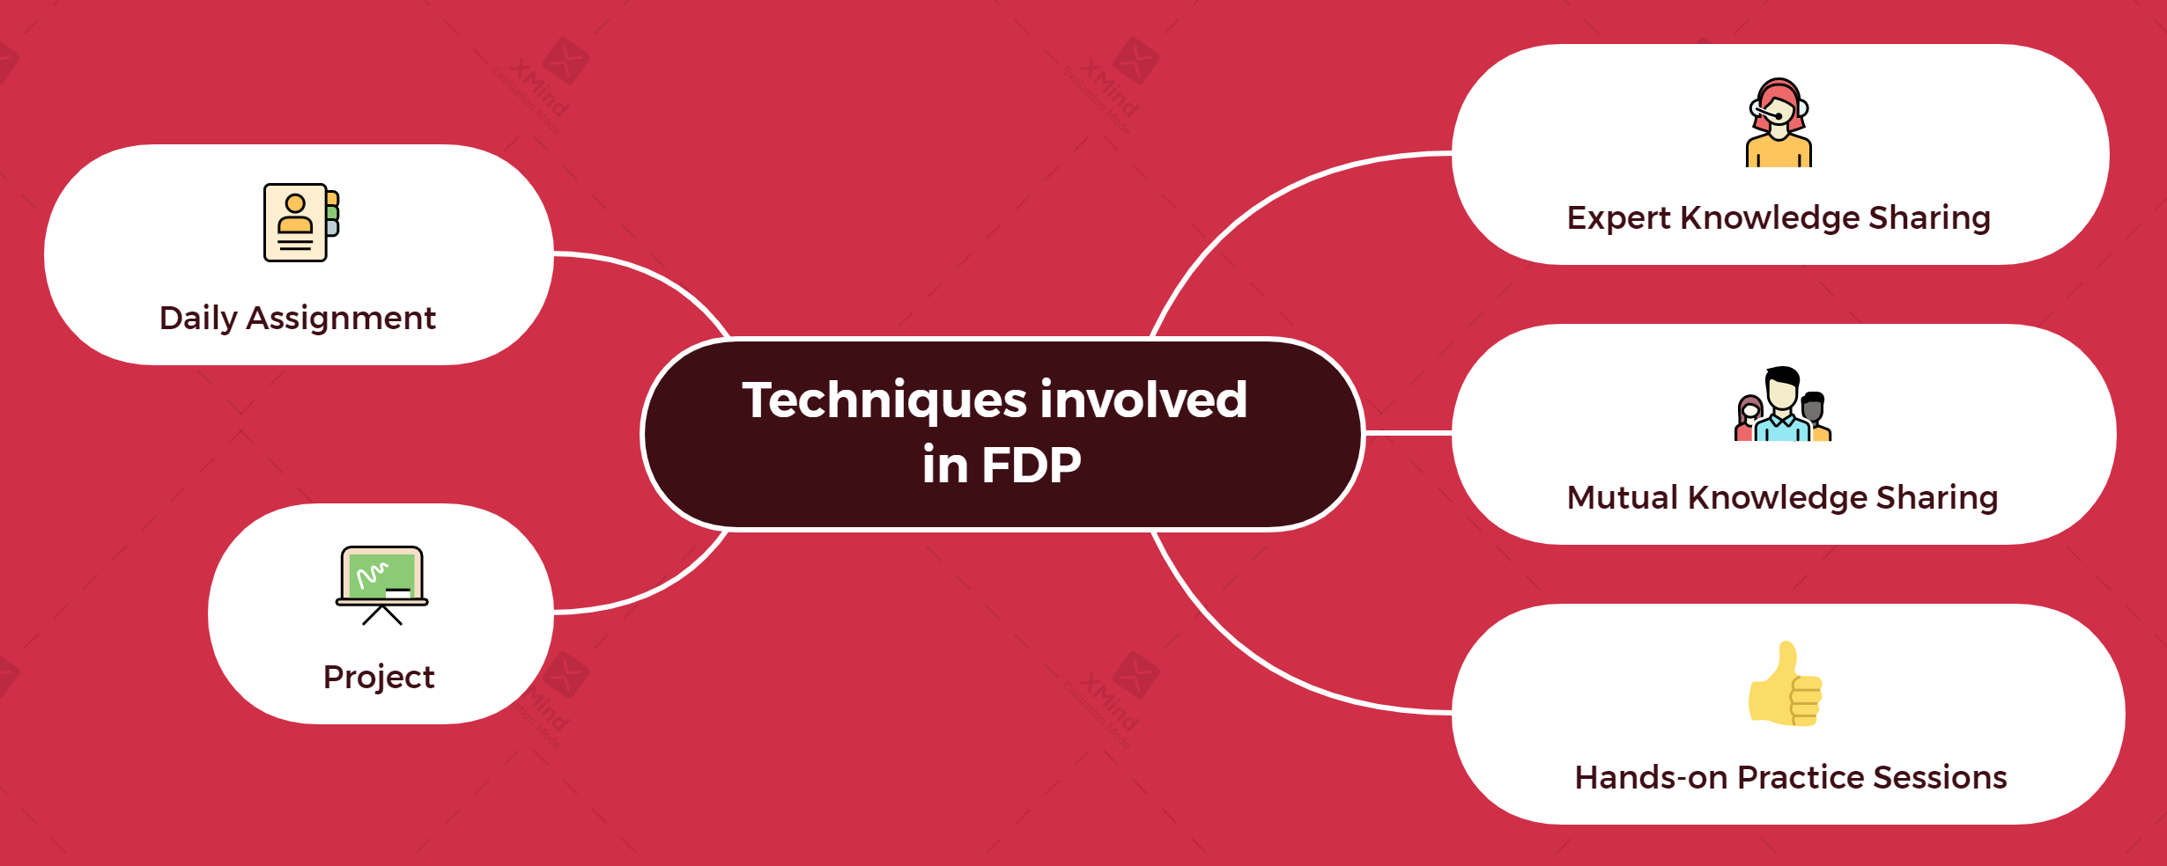

Slide 26
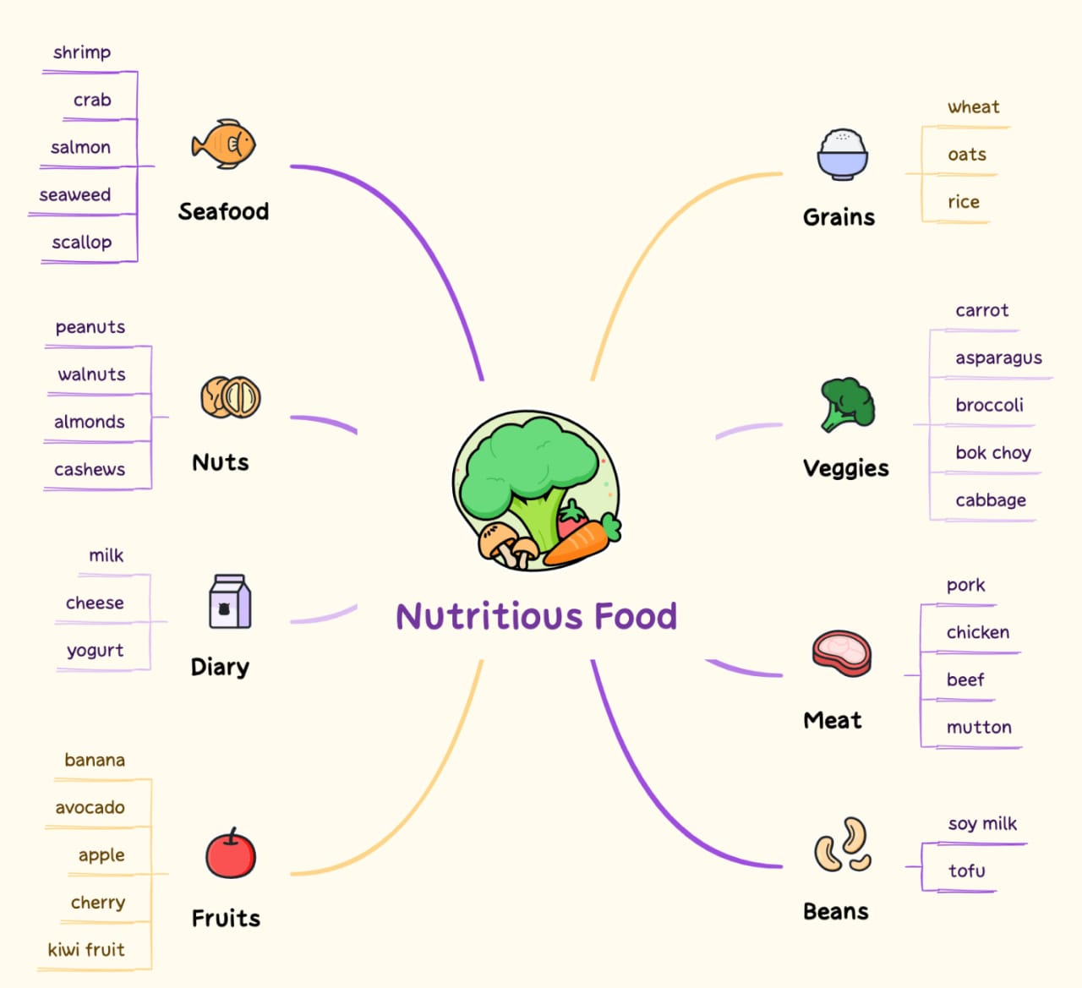

Slide 27
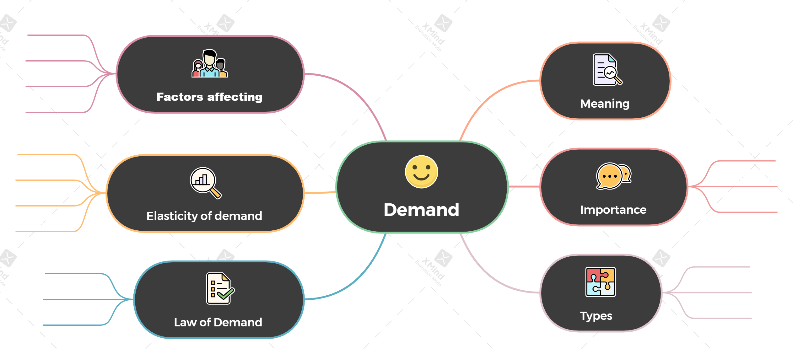

Slide 28
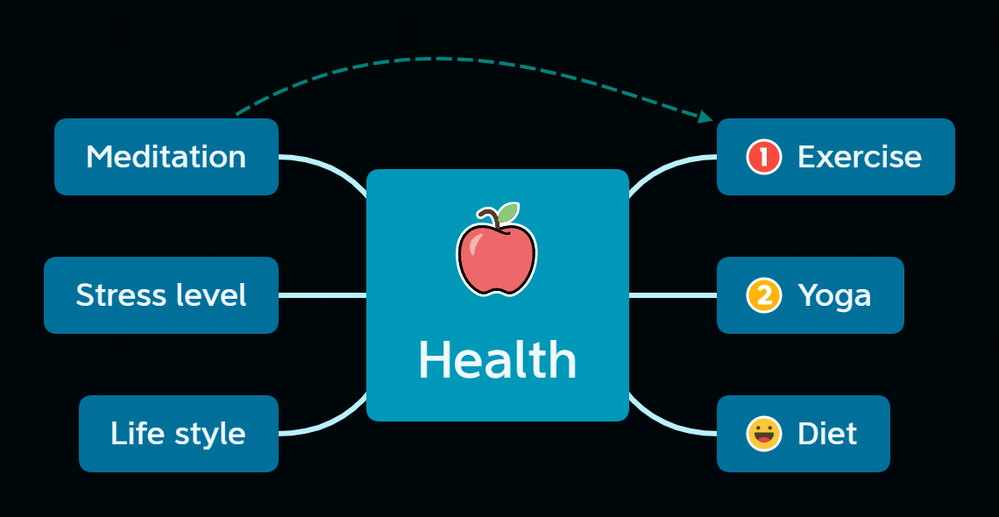

Slide 29
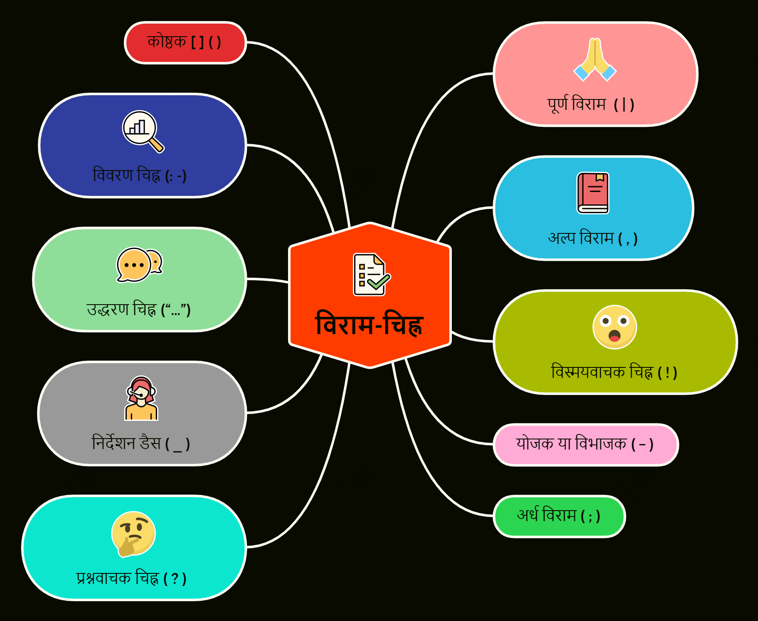
Hindi Mind-Maps

Slide 30
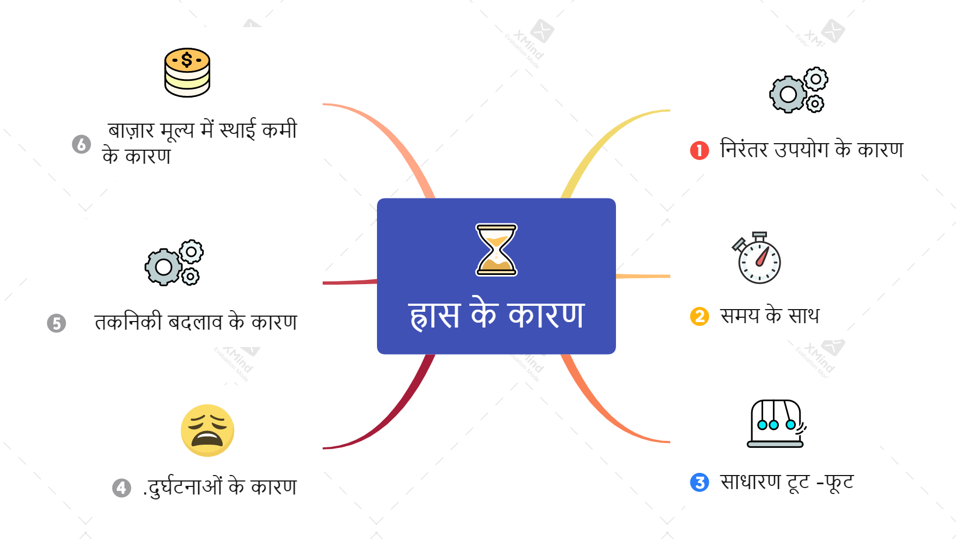

Slide 31

Hands-on practice session-Mind-Mapping
Xmind

Slide 32
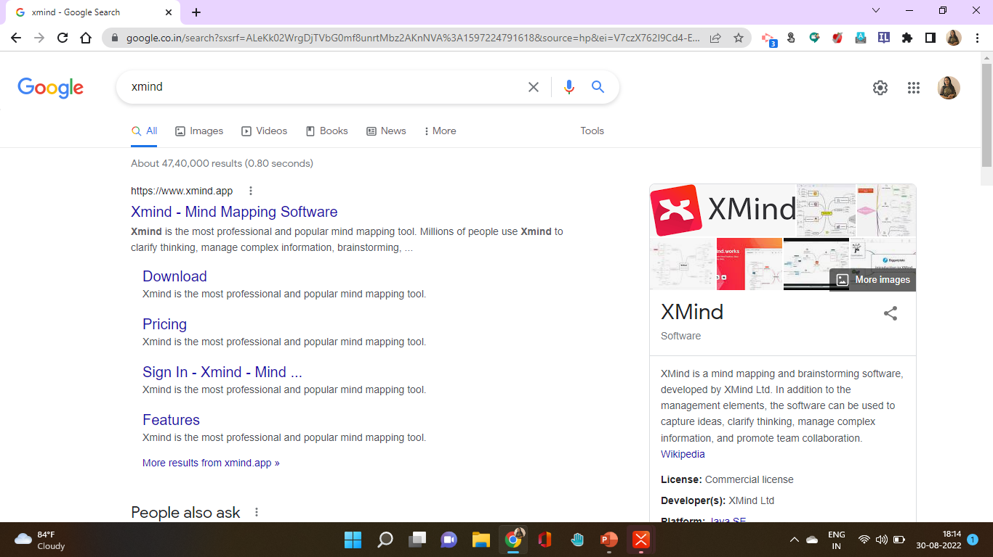

Slide 33
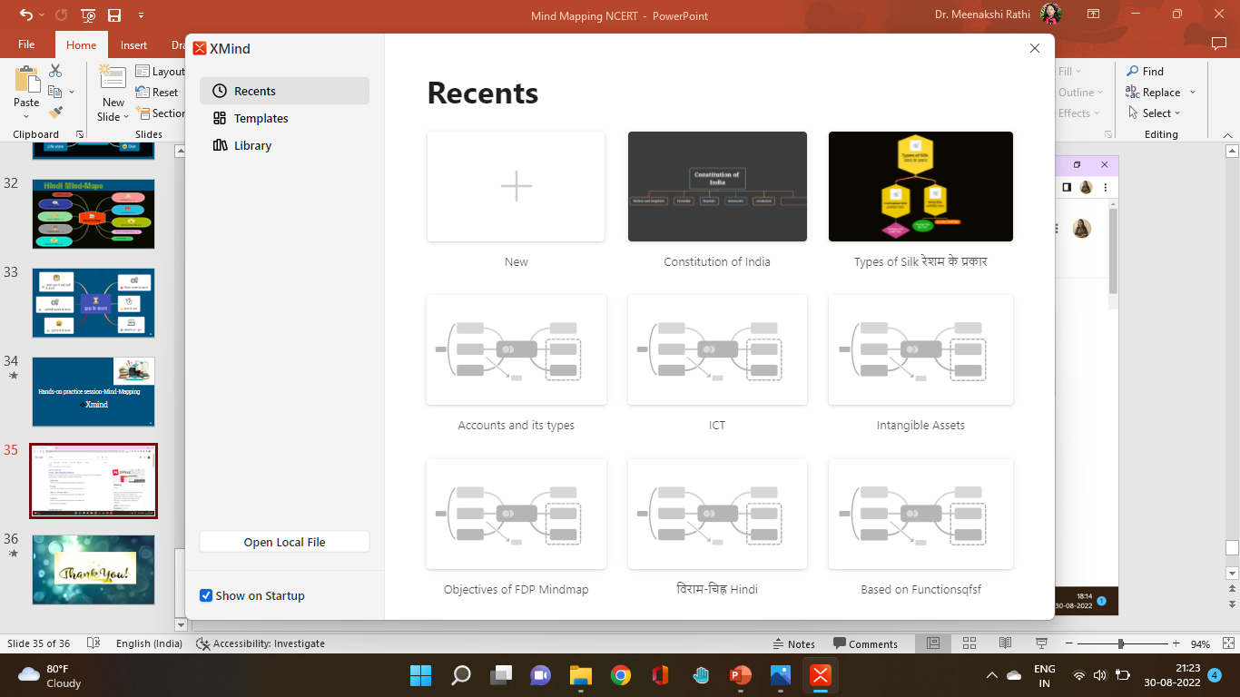
Recent: includes your recently created Mind-maps

Slide 34
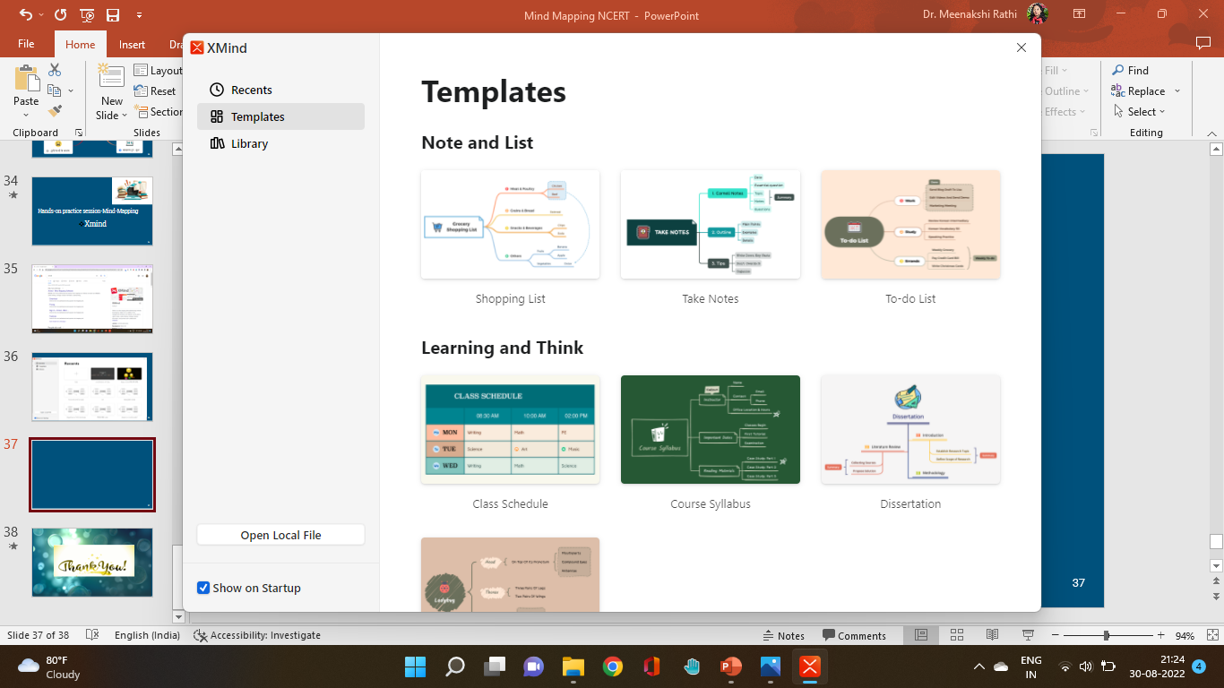
Templates includes already created designs

Slide 35
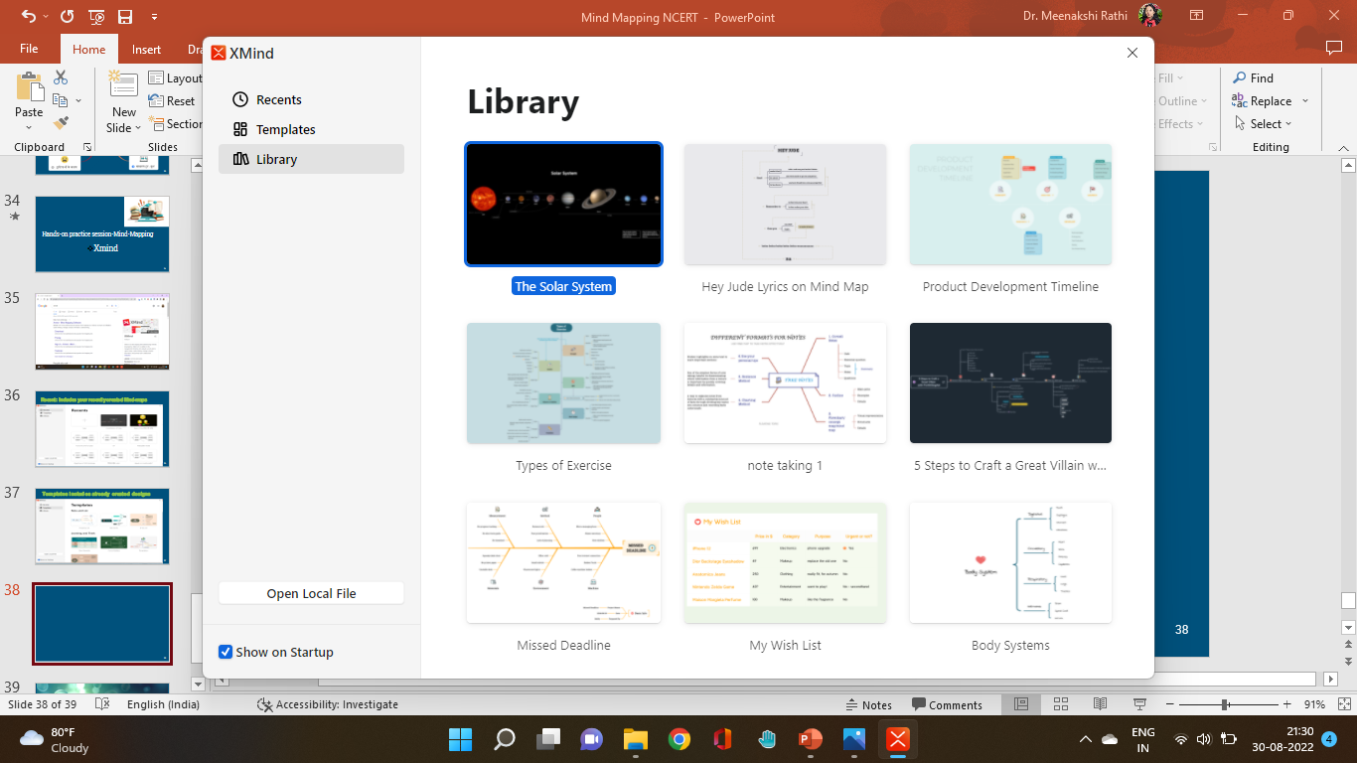
Library consist of

Slide 36
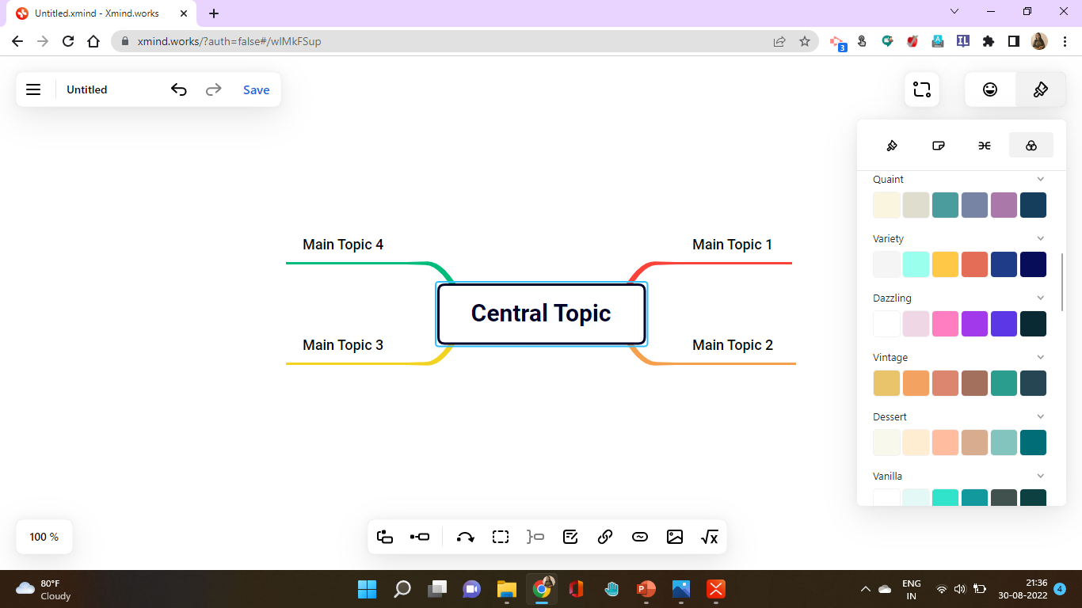
xmind.works

Slide 37
Summary
Creation of colourful Mind-map, colourful theme,
Adding relationships, shapes, hand drawn style, summary, boundary, notes, labels, audio notes, maths equations
Multiple layouts, Tree table, fishbone, logic chart, org chart, timeline
Insert Stickers, illustrations, marker, labels, icons
Share, export, import, map shot etc

Slide 38



